Slide 1

Your success is our success
API Security & Testing
Funny Gorilla诙猩猩-IT培训

Slide 2
Learning Objectives
By the end of this learning module, you will be able to understand:
Postman – API Testing Tool
What Postman can do
Use API specification in Postman
Check API response
Setting up pre-request scripts
Use environment variables
Setting up a mock server in Postman

Slide 3
Security Requirements
Confidentiality
Integrity
Authentication
Authorization
Non-Repudiation

Slide 4
API Security
Authentication
Authorization
Who you are
What you can do

Slide 5
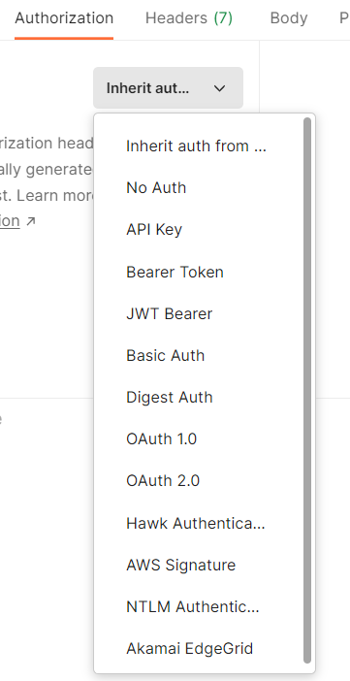
API Security in Postman
Basic Auth
Bearer Tokens
API Keys
AWS Signature
OAth 2.0

Slide 6
Basic Auth

Slide 7
Bearer Token

Slide 8
API Key

Slide 9
OAth 2.0 – Open Authorization
a standard designed to allow a website or application to access resources hosted by other web apps on behalf of a user.

Slide 10
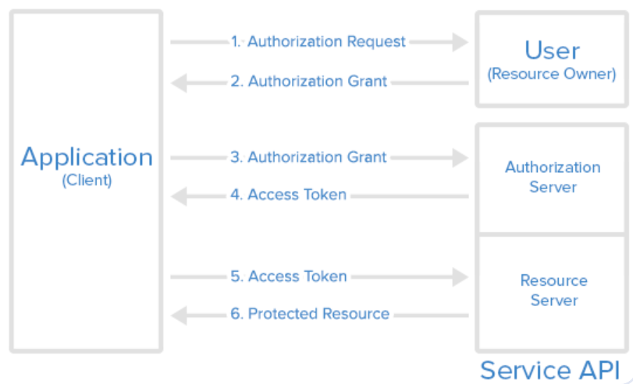
Explore API

Slide 11
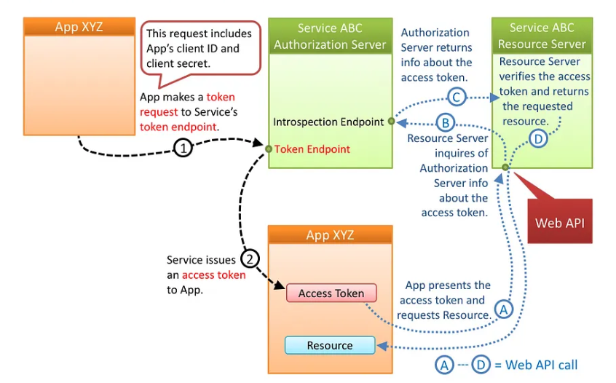
OAth 2.0

Slide 12
Explore API
Understand API Spec
Understand relationship between entities
Map out URL, action, response codes

Slide 13
Create a Collection

Slide 14
Execution Order of Scripts
Collection
Pre-request script
Folder
Pre-request script
Request
Response
Request
Pre-request script
Collection
Test script
Folder
Test script
Request
Test script
https://learning.postman.com/docs/writing-scripts/intro-to-scripts/

Slide 15
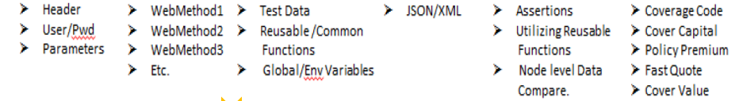
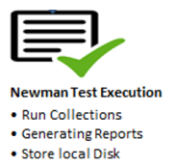
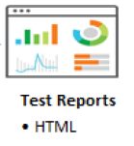
Request
Prerequisite Script
Request/
Response
Functional
Scripts
Authentication
Collection
Test Scripts

Slide 16
Security Testing
To do

Slide 17
Automating run collection
https://learning.postman.com/docs/running-collections/intro-to-collection-runs/

Slide 18
Automating run collection
https://learning.postman.com/docs/running-collections/intro-to-collection-runs/
Configuring a collection run
Running your collections: Collection Runner, Newman
Sharing collection runs
Automating collection runs

Slide 19
Newman Introduction
Postman's collection runner engine that sends API requests, receives the response, and then runs your test against the response.
It is like postman's command line companion that generates specified reports.
It is extensible and so can be integrated into continuous integration (CI/CD) servers and build systems.
Benefits of using Newman
➢ Makes it easy to run a collection of tests using command line 
➢ Gives the ability to run a collection of tests written in postman right from most build tools 
➢ Enables generating and storing report directly from the command line after Installing Newman.

Slide 20
References
https://learning.postman.com/docs/writing-scripts/script-references/test-examples/

Slide 21

Your success is our success
Contact
Mail: info@funnygorilla.com.au
Linkedin: https://mt.linkedin.com/in/songqing-gu-2ba9034b/de
Web Chat: FunnyGorilla
Phone: 0420891343

